Slide 1
THE DEMOGRAPHIC AND SOCIO-ECONOMIC DETERMINANTS OF THE GALAXIES
The demographic and socio-economic determinants include Education, Gender Inequality Index, Income and Old Age Dependency. All these factors contribute to the well-being of the galaxies.

Slide 2

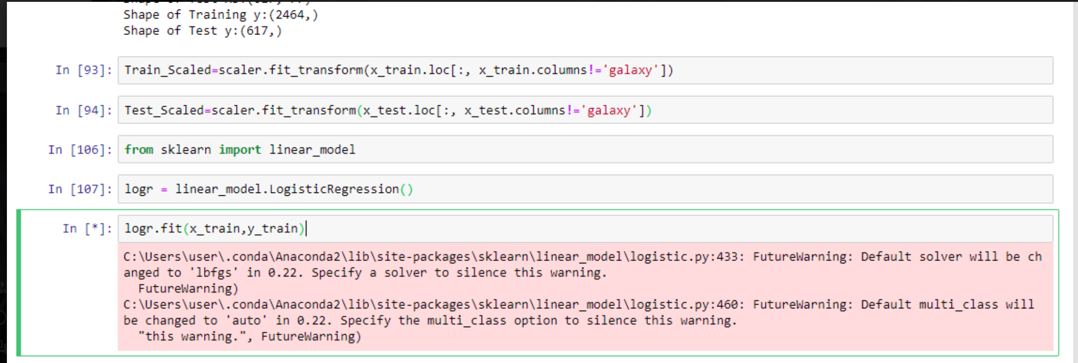
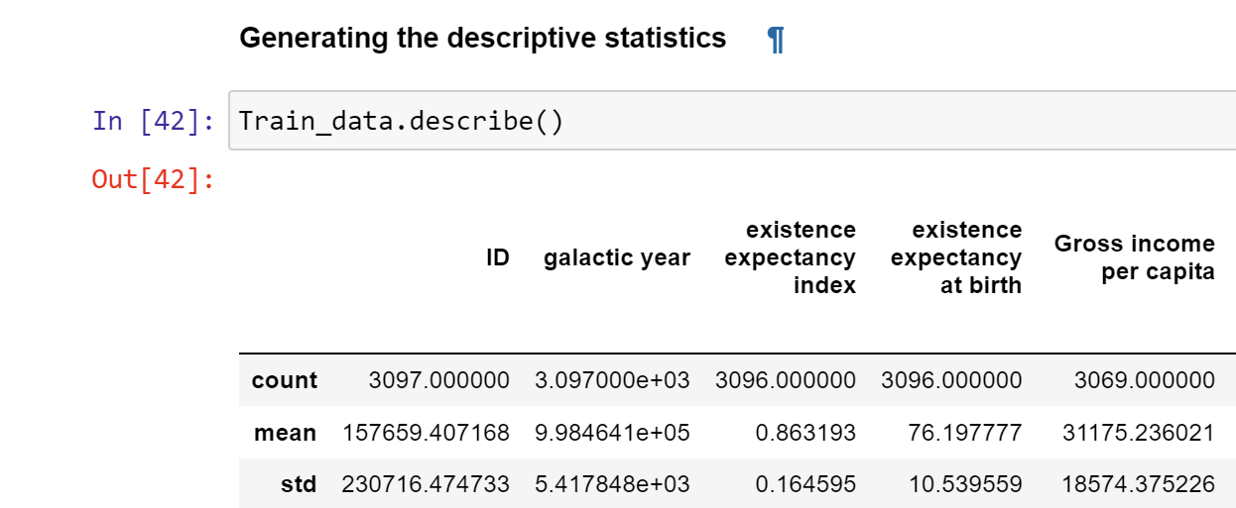
Methodology-Data Cleaning, Exploratory Data Analysis Modelling
Activities:-
Checking for the null values
Importing The train and validation datasets for exploration
Variable Identification and Typecasting
Getting the variables of interest
Modeling- Scaling the dataset using a min-max scaler

Slide 3

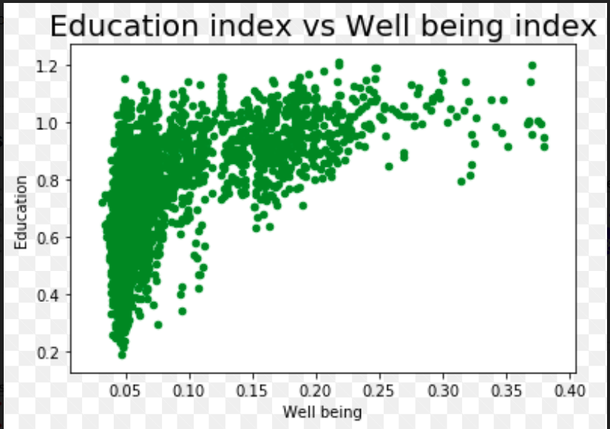

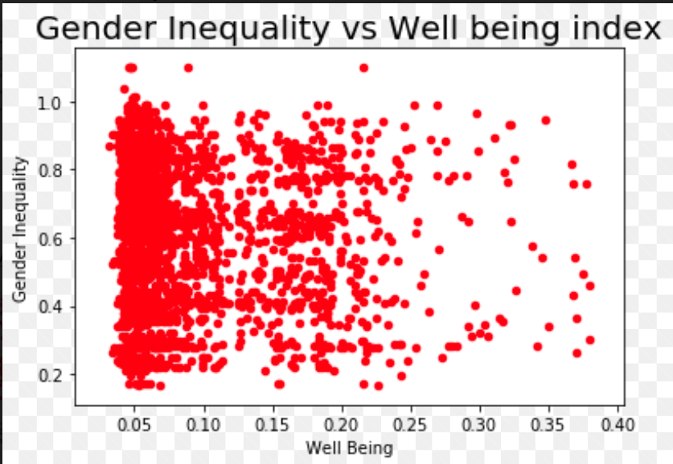
Education Vs Well-Being Index Gender Inequality Index(GII) Vs Well-Being Index
Exploratory Data Analysis (EDA)
The scatter plot shows a positive relationship between education and well-being as the marks tend to move in an upward direction hence positive. Educated people have knowledge to make rightful decisions regarding the quality of life desired.
GII encompasses gender-based disadvantage in three dimensions— reproductive health, empowerment and the labour market. Inequalities between male and female result into loss of potential development within the economy.
GII index and well-being have an inverse relationship; lower GII values represent a better performance regarding gender inequality and thus, higher well-being index. An economy that implements policies which ensures fairness and equality within the population will have higher levels of development and lower GII index.

Slide 4
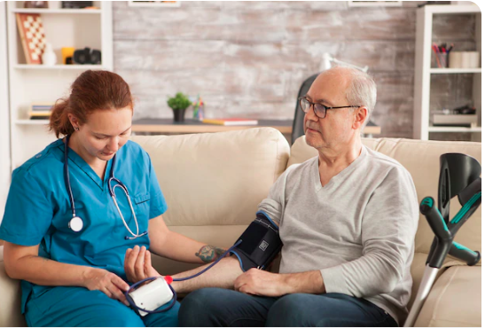
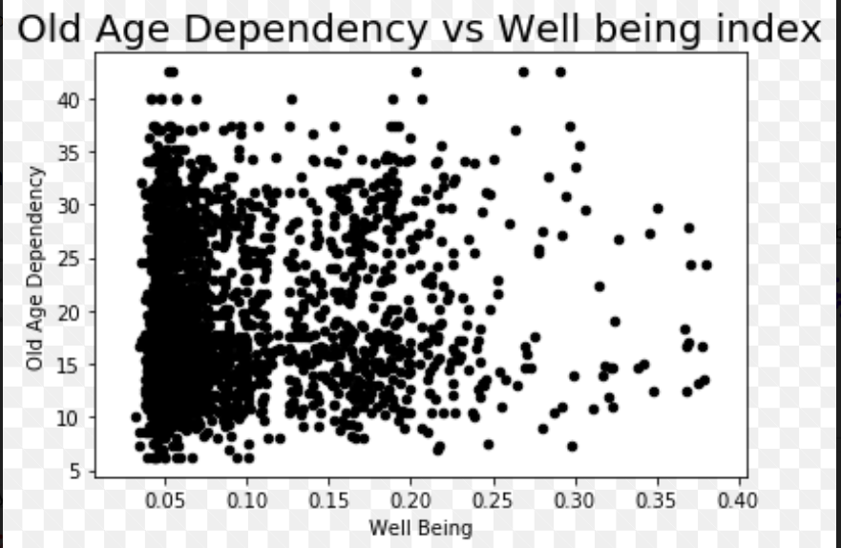
Old Age Dependency Vs Well-Being Index
EDA Cont…..
There is a negative relationship between old age dependency and the well-being. Individuals in old age are prone to terminal illnesses like diabetes, chronic obstructive pulmonary disease and dementia, which makes them more dependent on the younger population. The extra years of life are always dominated by declines in mental and physical capacity, which have negative implications for the aged and the society.
However, studies show that if the extra years of life are lived in good health and a supportive environment, it can be beneficial not only to the individuals and their families but, to the whole society.

Slide 5
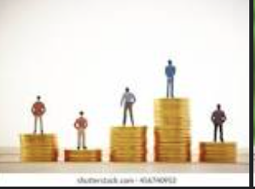
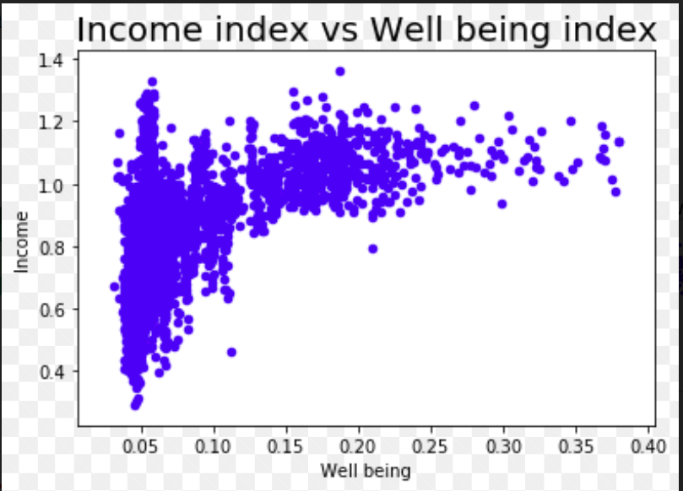
Income Index Vs Well-Being Index
EDA Cont…..
From the plot, most points tend upwards and to the right hence, a appositive relationship.
Income level determines the quality of life and thus the well-being. Higher income would mean easy access to quality healthcare and affordability of balanced diet. Additionally, high income gives individuals the ability to choose the type of lifestyle they would wish to have; they have more options in life at their disposal.
Studies show that individuals with high income levels have better lifestyles. They can afford international healthcare standards, frequent holidays, which are a contributing factor to mental health, and able to live in good neighborhoods with tranquil environments and good drainages.

Slide 6
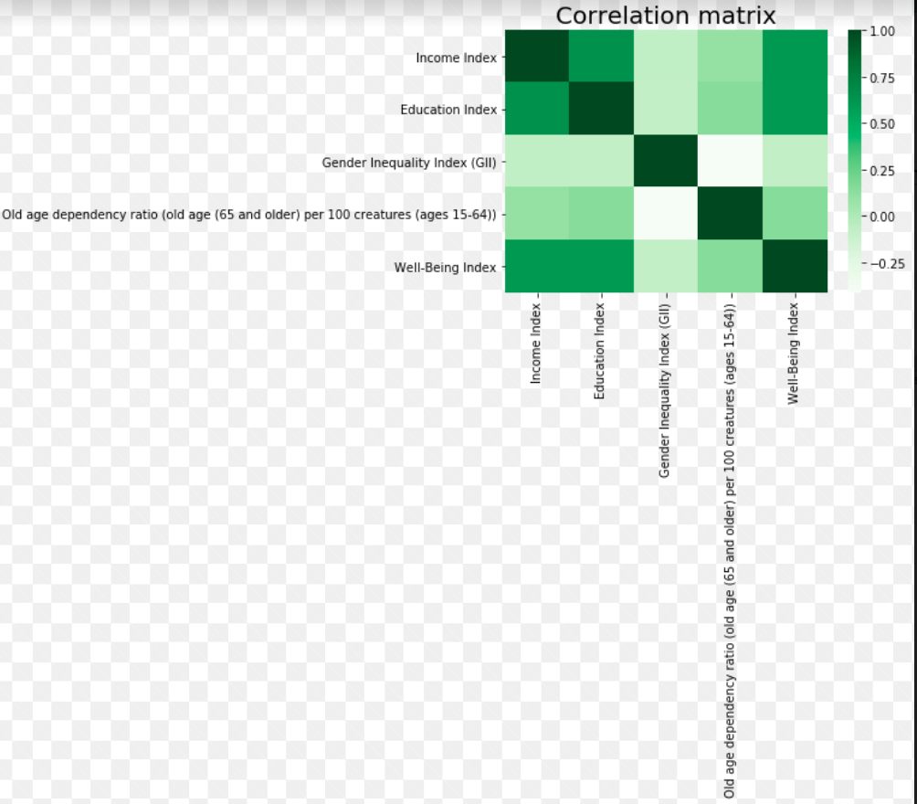
Heat map- Correlation Analysis
EDA Cont…..
From the correlation plot, it is clear that each variable affects the well-being of the galaxies, either positively or negatively.
The darker the box, the stronger the relationship. For example, from the plot, both income and education indices have a strong relationship with the well-being index. It implies that good education and high income result into a higher probability of a good life.
GII and old age dependency indices have an inverse relationship with well-being index.
Conclusion
There are several factors that contribute to the well- being index of an economy. The productivity and GDP is directly related to the health of individuals. Policy makers should formulate ideas that foster well-being and equal distribution of resources. There are several suggestions to push for more research on how to have a healthy ageing population, to ensure a safe world to grow old. Many countries have also collaborated initiatives to bridge the inequality gap between males and females.

Slide 7
References
https://www.who.int/news-room/fact-sheets/detail/ageing-and-health
https://harris.uchicago.edu/files/measuringthewellbeing.pdf

Slide 8

The End.

